Slide 1
Module 6
Collaborating with others to protect, preserve and promote Cultural Heritage at Destination level

Slide 2
TABLE OF CONTENTS
01
Introduction to collaborative processes
02
Involving your stakeholders
03
Collaborative strategies
04
Case studies and useful tools
05
References
2

Slide 3
“When you need to innovate, you need collaboration.”
Marissa Mayer
3

Slide 4
LEARNING OBJECTIVES
When you complete this module you will be able to:
Define the key categories of collaborators for a digital cultural heritage project
Describe 4 common mistakes when dealing with partners and collaborators
Describe 4 key steps in designing a partnership
4

Slide 5
Introduction to
collaborative processes

Slide 6
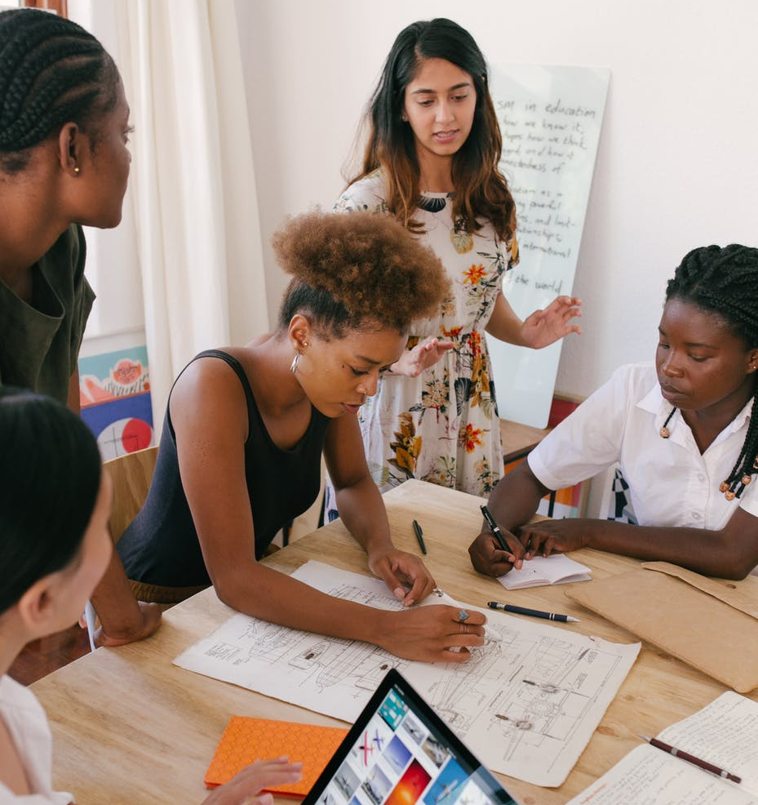
Collaborations in the cultural sector
One key characteristic of the cultural sector is that there are no real competitors: all cultural institutions pursue an underlying common mission to preserve and promote cultural heritage, to educate citizens and visitors and to share and foster knowledge. For this reason, it is particularly important to create partnerships and collaborations that will make it easier to achieve these common objectives.
6

Slide 7
Collaborations in the cultural sector
Collaboration can happen at all levels:
between different cultural organizations
between cultural institutions and organizations from different sectors
between cultural institutions and local communities
7

Slide 8
The importance of collaboration in the cultural sector is even more evident when designing and developing immersive digital cultural and tourism experiences due to their nature of complex processes that involve a broad range of stakeholders.
According to a recent research on digital readiness and innovation in museums, dedicated digital staffing is absent or very limited in half of the museums surveyed, especially in small-sized institutions.
8

Slide 9
It is thus clear that, in order to develop successful digital experiences, cultural organizations need to involve and collaborate with:
businesses such as tech companies and digital experts;
other museums to join forces and develop shared services to support their digital innovation.
9

Slide 10
Case study
Izi.TRAVEL is an open and free storytelling platform born in 2011 with the aim to connect cities, museums and their stories with travelers.
The platform created a dynamic hub where thousands of content providers can easily create multimedia guides for millions of travelers. This collaborative approach allows everyone to create content for museums and cities, providing engaging contents to visitors and enabling the fast growth of the platform.
10

Slide 11
Involving your
stakeholders

Slide 12
INVOLVE AND COLLABORATE
Projects of immersive tourism experiences are encompassing very different fields and so they often involve different professions, institutions, skills and viewpoints, demanding the creation of collaborations that require preparation, argumentation and consensus building.
There is no catch-all recipe for working in interdisciplinary groups but, as initiators of a project, we should at the very start inform and involve all stakeholders in our interests, plans and timelines in order to set the frameworks for collaborations and potential involvement. Transparent communication ensures an honest opportunity for stakeholders to take part.

Slide 13
INVOLVE AND COLLABORATE
Collaboration should be seen as an opportunity for better results - opening up the process to different stakeholders can massively increase the skills you have access to and the results that you get.
A tip! Gather as much information as you can about the cultural heritage in question. The more material (graphic, audio…) gathered, the more opportunities it gives to collaborate with creative and cultural industries such as:
graphic and multimedia designers;
artists;
architects;
programmers and others.

Slide 14
Stakeholders’ involvement
Many professions and interest groups have a stake in immersive tourism experiences and could contribute with valuable insights.
Yet not everyone should be involved into everything. An important aspect of stakeholder involvement are competencies!
Stakeholder involvement should always take into consideration knowledge, background and aspirations of stakeholders – keep that in mind to get the most constructive feedback and insights out of stakeholders’ involvement.
14
Notes:
Is there a step here before looking for stakeholders about defining the core competencies and resources that you have and those you need to pull in by working with partners?

Slide 15
Expertise of the cultural heritage key stakeholders
Here is a summary of the categories of stakeholders to be involved and the stages at which they most likely will need to be involved.
 | Permits | Professional Guidance | Materials | Ideas | Testing | Implementation And Support
Museum Experts
Museum, Folklore, Etc. Cultural Heritage NGOs
Artists And Other Creators
Other Experts (E.G. Architects, Machinists, Historians, Ethnologists)
Universities & Schools
Youth Org. And Other Cultural Ngos
Tech. Companies
Tourism Companies And Support Organisations
15
Notes:
Do government bodies have a role?

Slide 16
Collaborative
strategies

Slide 17
BUILDING AN EFFECTIVE PARTNERSHIP
Starting a collaboration may seem hard at the beginning, some of the most common mistakes made by organizations engaging in partnerships (and that you should therefore be careful to avoid) are:
MISTAKING COLLABORATORS FOR SUPPLIERS: it is important not to adopt a client-supplier perspective when interacting with your partners, they are your peers!
NOT DEDICATING ENOUGH TIME OR RESOURCES: creating a partnership is an investment, be honest about the amount of time and resources that you can dedicate and be consistent with it.
Notes:
Excellent slide.

Slide 18
BUILDING AN EFFECTIVE PARTNERSHIP
NOT HAVING THE SAME LONG-TERM OBJECTIVES: it is important to define with your partners a balance between immediate goals and the long term cultural impact the you seek to create.
NOT LEVERAGING CORE ASSETS: find partners that have competencies complementary to yours and that share with you the same mission, strategy and activities to make a real change!
Notes:
Excellent slide.

Slide 19
4 key steps to design your next partnership
In the following slides there are 4 key steps to join forces effectively and accelerate positive change within the organizations involved and towards the external environment.
19

Slide 20
Understand the ecosystem: look at the bigger context and map your stakeholders, the forces at stake and the improvement areas in order to plan your strategy accordingly. How: organize a meeting with your colleagues and use a canvas to write down all the stakeholders involved by your cultural organization. Here you can find an example of canvas to be used: servicedesigntools.org/tools/ecosystem-map
Scope your objectives: set a clear vision of the long term objectives that you want to achieve through the creation of the partnership and define the role that you will have throughout the journey. How: list the 3 main objectives that you want to achieve within the next 5 years and outline a strategy for each of them trying to understand if you can do it by yourself or if you need partners, and if so, who.
20

Slide 21
Define your approach: determine with your partners how you plan to achieve your objectives, tackle problems and generate added value to ease collaborative processes. How: once you’ve defined which objectives require partners, get in touch with them to define a shared strategy. Organize a brief introductory meeting followed by a co-creation session during which everyone writes down their point of view, then discuss them collaboratively to define a shared approach.
Design your partnership: what business model will you adopt? How will the activities be divided between the partners? What is the work-flow? Be sure to answer all these questions at the beginning of the collaboration. How: now it’s time to define a precise plan to put your strategy into practice! Set clear intermediate objectives and appoint a responsible person for each of them, organize periodic meetings to be sure that everyone is on track and to keep an open dialogue with your partners.
21

Slide 22
Case studies
and useful tools

Slide 23
Get Inspired…
The Sanxingdui Museum and Tencent, China
The Sanxingdui Museum established a collaboration with Tencent to reach younger generations and to become more internationally renowned, harnessing the power of digital technology through a strategic collaboration.
Link

Slide 24
Get Inspired…
L’Internationale, Europe
L’Internationale is a consortium of seven European modern art museums that joined their forces to produce a common program of exhibitions, debates and online projects.
Link

Slide 25
Get Inspired…
The Valentine Museum and ARtGlass, USA
The Valentine museum launched an AR walking tour in partnership with ARtGlass to change the citizens’ and visitors’ perception of the city and of its public art monuments.
Link

Slide 26
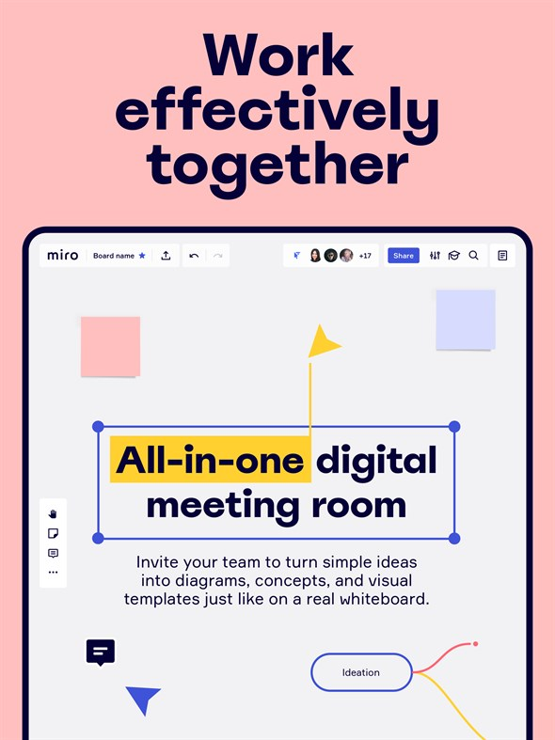
Useful tool
Miro is an online platform that allows teams of all dimensions to collaborate remotely and in a visually appealing way.
It provides:
digital versatile whiteboards for brainstorming sessions, planning, etc.
a great range of canvas and templates to spark inspiration or to better organize partners’ contributions
multiple features (e.g. post-its and drawings) to express and share ideas
26

Slide 27
References
Povoledo (2021), Vaccination Can Be Relaxing. Just Ask These Museum Visitors, accessible at: https://cutt.ly/sEuwzH0
Knight Foundation (2020), Digital Readiness and Innovation in Museums, accessible at: https://cutt.ly/ZEuo94l
Min Chen (2021), How Digital Asset Management Supports Museums’ Missions, accessible at: https://cutt.ly/EnTxXXB
Board of Innovation (2021), The Comprehensive Guide to Impact Partnerships, accessible at: https://cutt.ly/1RLbR4x
Whiddington (2021), With A Tencent Partnership, Sanxingdui Museum Goes All In On Its Cultural IP, accessible at: https://cutt.ly/7WzKssj
L’Internationale: https://www.internationaleonline.org/
Whiddington (2021), Inside The Valentine Museum’s AR Tour That’s Recontextualizing Historical Sites: https://cutt.ly/7Wz6mzy
Miro: https://www.miro.com/

Slide 28
Thank you for your attention!
Any questions?

